Slide 1
Predicting NOx values using Linear Modeling Techniques
Introduction: This presentation focuses on predicting NOx values using pollution data and linear modeling techniques to manage air pollution levels and improve sustainability in urban areas.

Slide 2
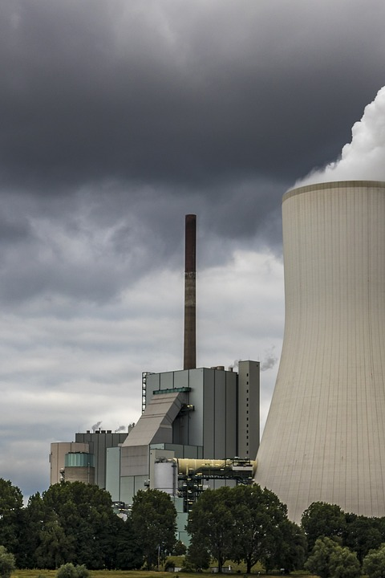
Problem Statement
NOx is a major pollutant in urban areas.
Predicting NOx values can help manage air pollution levels and improve sustainability.

Slide 3

Methodology
Data on pollution levels and NOx values was collected and analyzed.
Statistically relevant response parameters were identified using multiple linear regression analysis.
Linear modeling techniques were used to develop a model for predicting NOx values.

Slide 4
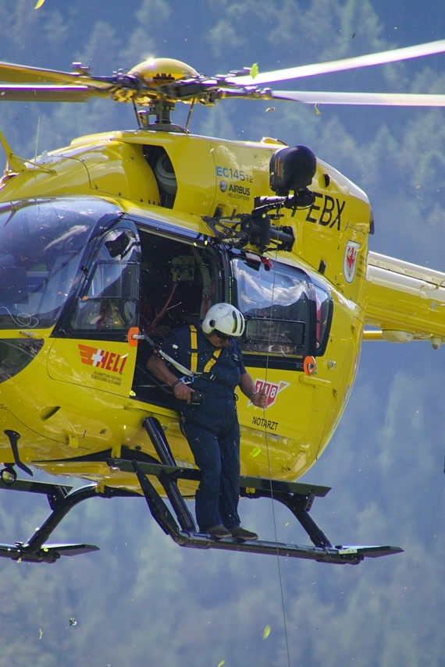
Results
Temperature, humidity, Ozone, and non metallic hydrocarbons have a significant impact on NOx values.
A linear model was developed and accurately predicted NOx values.
The accuracy of the model was evaluated using the RMSE and MAPE values.

Slide 5
Conclusion
Linear modeling techniques can effectively predict NOx values using pollution data.
By identifying statistically relevant response parameters, accurate predictions can be made.
This study demonstrates the potential of linear modeling techniques for managing air pollution levels and improving the sustainability of urban areas.

Slide 6
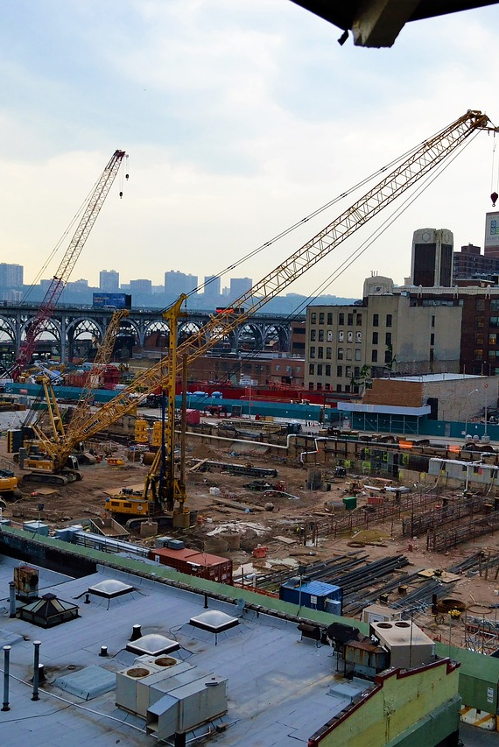
Future Scope
Further research can explore the use of additional parameters for more accurate predictions.
The developed model can be integrated into air quality management systems for real-time monitoring.

Slide 7
Thank you. Please feel free to ask any questions. 😄

